Slide 1

Real-Time Heart Simulation
Author: Yuecheng Rong & Yinsheng Dong
Supervisor: Raymond.J.Spiteri
(yur013@mail.usask.ca, 11177862)
(yid164@mail.usask.ca, 11148648)
Department of Computer Science

Slide 2
Outline
Review the Real-Time Heart Simulations
The basic concepts
Our Initial Ideas about the project
What we analysed and our Attempts
Milestones we reached
Future
‹#›

Slide 3
Review
What is Real-Time Heart Simulation and our approaches:
create a simulation of a. piece of heart tissue on the computer and make the tissue active as ‘real-time’ as possible
manipulation: the tissue consists of vast copies of cell models represented by mathematical models solved by numerical methods

Slide 4
Review
Why the GPU Heart Simulation is important?
Cardiac dynamic modeling is useful for studying and treating arrhythmia.
Nowadays, when we do a simulation, CPU can solve about 10^8 ordinary differential equations (ODEs) per second, but GPU can solve 3 x 10^10 to 4 x 10^10 ODEs per second by using parallel programming.

Slide 5
Basic Concepts: what are we calculating
Cell models:
Voltage
States
Gating-variables
Non-gating variables
Ordinary differential equations
Monodomain model
Numerical methods:
Solve ODEs

Slide 6
Our Initial Idea
On Browser
By using WebGL (GPU.js and Tensorflow.js) to reach the simulation for fitting different platforms
Implementing some numeric methods on GLSL (OpenGL shading language)
Automation/Integration of all cell models from .cellml files (which contain the heart cells’ ODEs) by using Myokit (Python Toolkit)

Slide 7
Our Attempts and Analysis
We used WebGL to hard code a cell model (Fitzhugh-Nagumo) by using Forward Euler method.
We found WebGL has some limits
I/O problem
Since GLSL can only input/output textures and shaders, it is not easy to do the automation
If we use it, we have to hard code all of the models that we used, which is not our goal.
Precision issues
WebGL in currently version only supports 32-bit float, but we are supposed to use double precision on ODE for making models interact with each other.
Notes:
To guarantee the data accuracy, we need to get cell models from their official website, they used .cellml files to store the cell models, and these files are not programmable. One of our goals is automate these files, So we initially used their official SDK to extract the datas, however, the SDK they provided has a lots of issue. They only runs in native JVM which has very slow performance, their API documents are not well written, also, by our testing, the SDK only runs in Linux machines. For dealing these issues, we found another tool which called myokit which is a python toolbox which can modelize the .cellml files to programmable languages such as python, opencl, matlab etc. We spent 40 hours on these case, but fortunately, we have addressed this problem

Slide 8
Our Attempts and Analysis
We used OpenCL and CUDA by using PyOpenCL and PyCUDA
Because Myokit is based on Python, we thought it would be convenient to invoke cell models’ parameters, but the kernel was difficult to use.
Translating problem
CUDA and CL Kernels use special structures.
To do the automation, we are to write a translator for translating Python code to these Kernel Code.
Real-Time Problem
When we use the CUDA or OpenCL, the computation will be fast, but the rendering requires more time.
Notes:
To guarantee the data accuracy, we need to get cell models from their official website, they used .cellml files to store the cell models, and these files are not programmable. One of our goals is automate these files, So we initially used their official SDK to extract the datas, however, the SDK they provided has a lots of issue. They only runs in native JVM which has very slow performance, their API documents are not well written, also, by our testing, the SDK only runs in Linux machines. For dealing these issues, we found another tool which called myokit which is a python toolbox which can modelize the .cellml files to programmable languages such as python, opencl, matlab etc. We spent 40 hours on these case, but fortunately, we have addressed this problem

Slide 9
Our Attempts and Analysis
Julia is a farrelly new language, and it is friendly for Scientific Computation.
It natively supports Python Libraries
By using “PyCall” Package
So we can invoke Myokit easily
It supports GPU programming
By using “CuArrays” and “CLArrays” to do the automation.
It provides many of mathematical libraries which help us solve equations faster
By using “DifferentialEquation.jl” Package
Notes:
To guarantee the data accuracy, we need to get cell models from their official website, they used .cellml files to store the cell models, and these files are not programmable. One of our goals is automate these files, So we initially used their official SDK to extract the datas, however, the SDK they provided has a lots of issue. They only runs in native JVM which has very slow performance, their API documents are not well written, also, by our testing, the SDK only runs in Linux machines. For dealing these issues, we found another tool which called myokit which is a python toolbox which can modelize the .cellml files to programmable languages such as python, opencl, matlab etc. We spent 40 hours on these case, but fortunately, we have addressed this problem

Slide 10
Milestones We Have Reached
We have done decompositions and re-integrations of the .cellml files to the database on Python.
We made the cell model prototype on WebGL
We made the .cu and .cl kernels for CUDA and OpenCL
We have compared the benchmark on CPU computations and GPU computations on Julia.
We tried 4 ODE solver methods (Euler, RK2, RL, RKC) on CPU
We are implementing Monodomain model and GPU programming

Slide 11
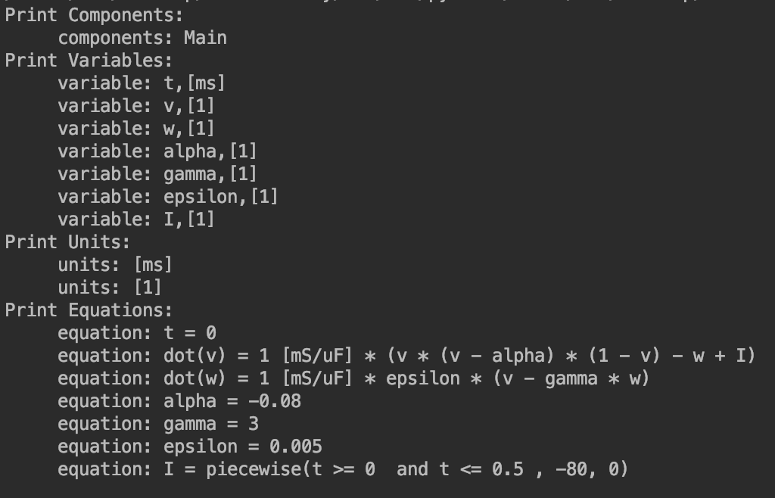
Cellml Structure
Data Result from .cellml files:
Notes:
This is one of our initial data results which is invoked by python myokit. The cell model name is Fitzhugh-Nagumo we got the components, variables, units, equations. Right now, we have the correct datas, so we are able to build the database.

Slide 12
Testing Environment
Processor:
Intel® Core™ i7-4770K CPU @ 3.50GHz × 8
Graphics:
Nvidia GeForce GTX 670/PCIe/SSE2
OS type:
Ubuntu 18.04.2 LTS
Benchmark Tool:
Julia “Testing” and “Benchmark” Packages

Slide 13
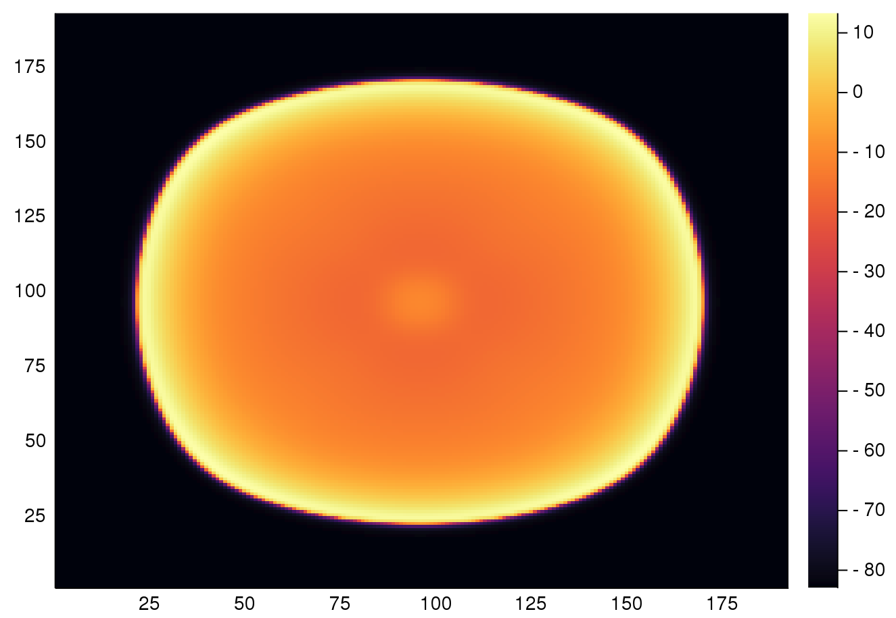
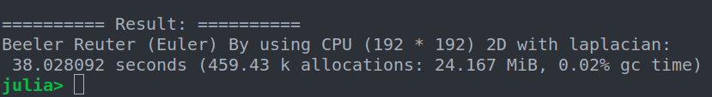
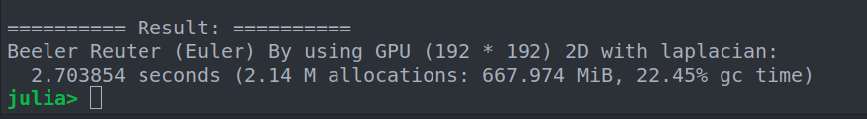
Comparison GPU and CPU

Slide 14
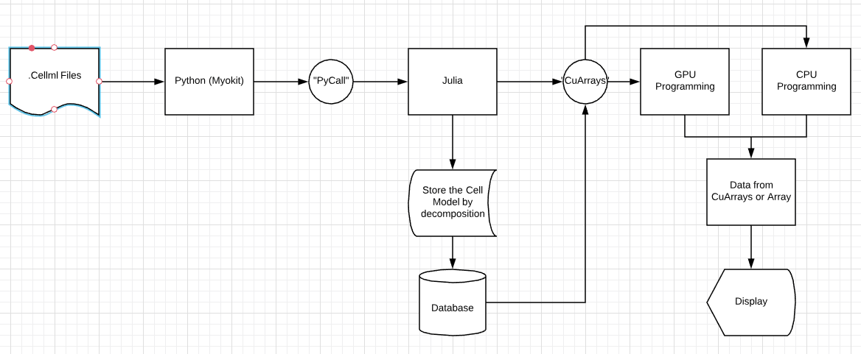
Project Structure
Process Flow

Slide 15
Result
Models:
Fitzhugh-Nagumo
Voltage + 1 state = 2 ODEs
Beeler-Reuter
Voltage + 1 non-gating variable + 6 gating variable = 8 ODEs
Luo-Rudy
Voltage + 1 non-gating variable + 6 gating variable = 8 ODEs
Ten Tusscher
Voltage + 6 non-gating variable + 12 gating variable = 19 ODEs
Partial differential equations

Slide 16
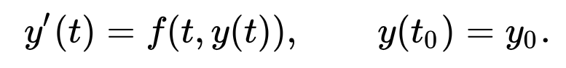
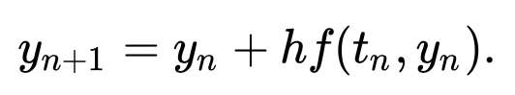
Result
Methods:
Forward Euler

Slide 17
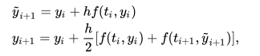
Result
Methods:
Runge-Kutta 2nd order (Heun’s)

Slide 18
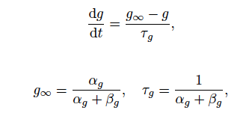
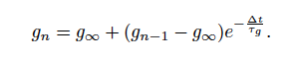
Result
Methods:
Rush-Larsen

Slide 19
What will affect the calculation time
stability requirement for each model:
t = 1000ms, dt = 0.1
vs
t = 1000ms, dt = 0.0001

Slide 20
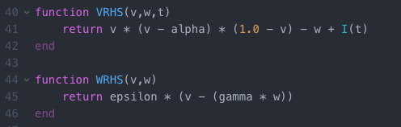
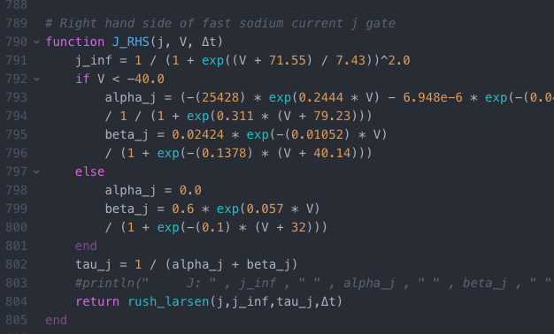
What will affect the calculation time
Complexity and number of equations
FitzHugh-Nagumo
Ten Tusscher

Slide 21

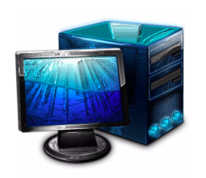
What will affect the calculation time
Device
MacOS Mojave
Processor:
Intel® Core™ i5 CPU @ 1.8Ghz
Graphics:
Intel HD Graphics 6000 1536MB
Test Desktop
Processor:
Intel® Core™ i7-4770K CPU @ 3.50GHz × 8
Graphics:
Nvidia GeForce GTX 670/PCIe/SSE2

Slide 22
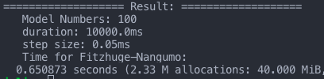
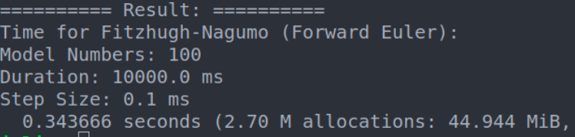
Fitzhuge-Nagumo：(Forward Euler)
MacOS
Home Desktop

Slide 23
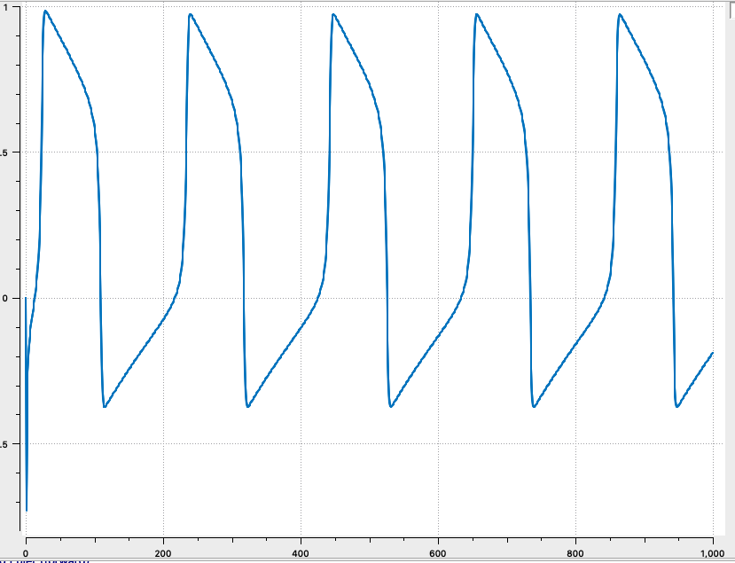
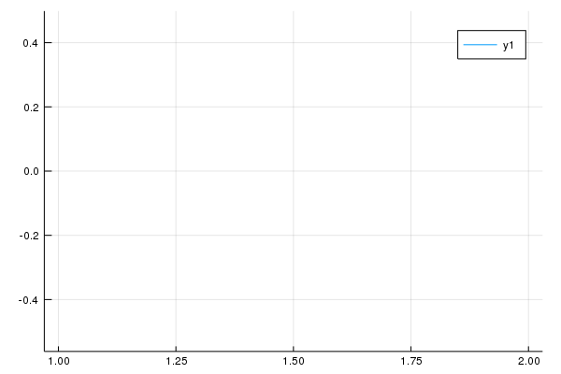
Fitzhuge-Nagumo：(Forward Euler)
Vision from CellML
vision plotted from our project

Slide 24
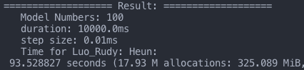
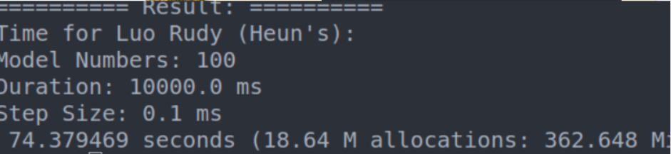
Luo-Rudy：RK2 (Heun)
MacOS
Home Desktop

Slide 25
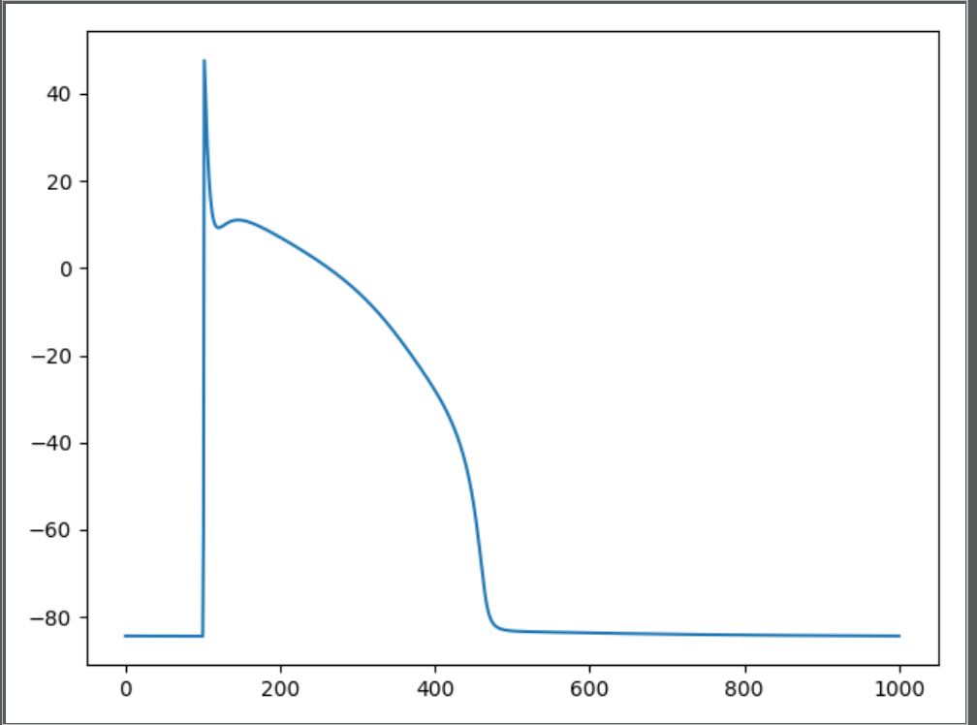
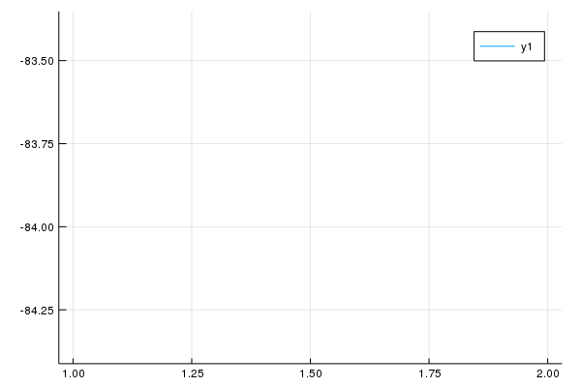
Luo-Rudy：RK2 (Heun)
Vision from CellML
vision plotted from our project

Slide 26
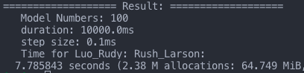
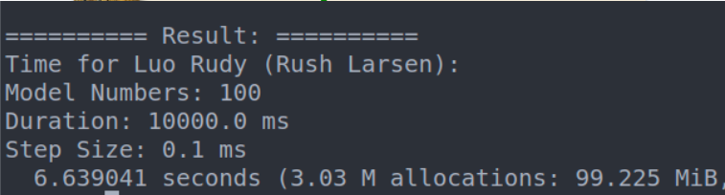
Luo-Rudy：Rush-Larson
MacOS
Home Desktop

Slide 27

Luo-Rudy：Rush-Larsen
Vision from CellML
vision plotted from our project

Slide 28
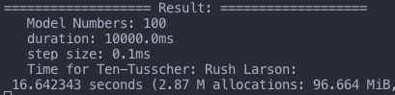
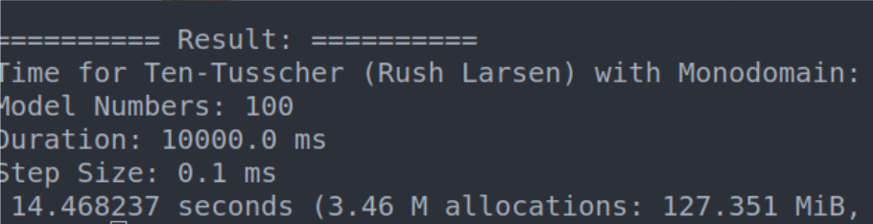
Ten Tusscher: Rush-Larsen
MacOS
Home Desktop

Slide 29
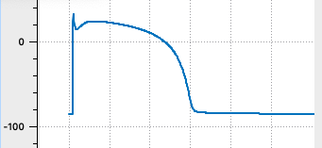
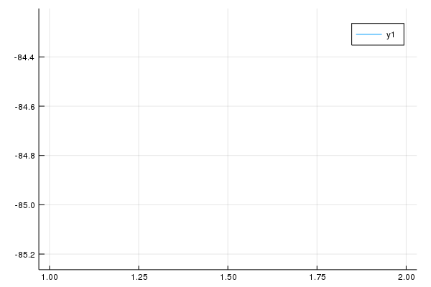
Ten Tusscher: Rush-Larsen
Vision from CellML
vision plotted from our project

Slide 30
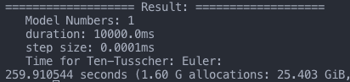
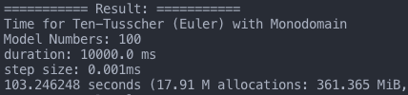
Ten Tusscher: Forward Euler
MacOS
Home Desktop

Slide 31
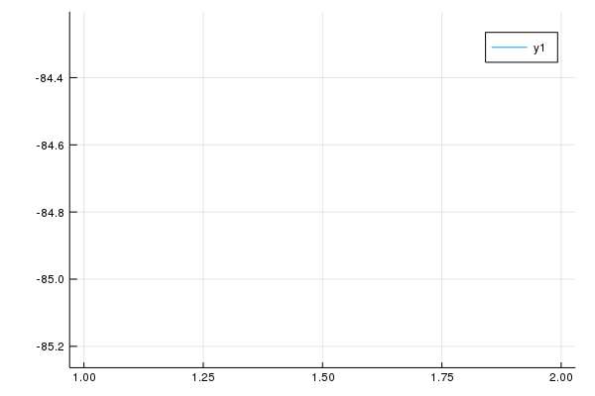
Ten Tusscher: Forward Euler
Vision from CellML
vision plotted from our project

Slide 32
Conclusions
We learned lots of mathematics such as ODEs, PDEs and Numerical methods. By using numerical methods, we get our datas out, and fortunately, we made some successful implementation
It is not easy to do implementations of scientific computations on GPUs because the GPU programming is totally different from CPUs.
We have attempted lots of ways to reach our goal (Python, JavaScript, OpenCL, CUDA, and Julia etc.), and we also failed many times.

Slide 33
Future
GPU programming for all the models
To implement more cell models and mathematical methods (use code automation)
To finish our integration code for database
To reach the real-time
Use 2D / 3D instead of 1D

